Slide 1

Jahezli
Reservation app

Slide 2
Introduction
The application is for table reservations.
This app aims to help customers reserve a suitable table before arriving at the restaurant.
The application provides a variety of services.
In addition, the customer can then pay for the service/s in different ways.

Slide 3
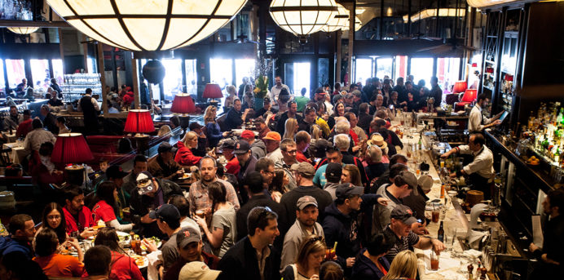
Problem statement
Restaurants and cafes are experiencing overcrowding issues causing customers to wait for a long time for a table wasting the customer's time upon arrival.

Slide 4

Solution
Create an application that allows customers to reserve a table before arriving.
To avoid congestion and long waits as well as processing the order in advance, which helps customers not to waste their time.

Slide 5
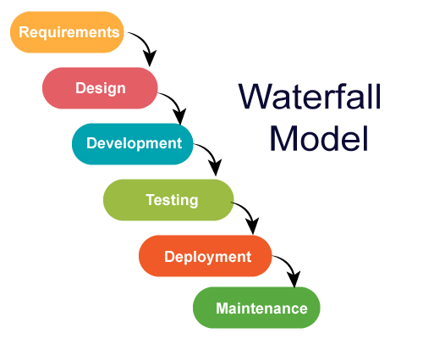
Approach and Process
Waterfall methodology This method was chosen because of several reasons
The application is not complicated.
Focuses on determining the requirements.
The model develops systematically from one phase to another in downward motion without going backward.

Slide 6
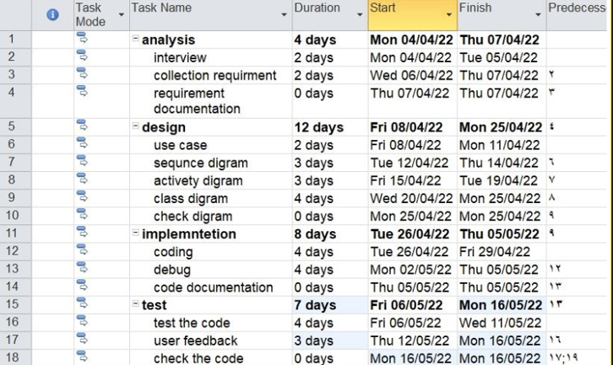
MS project Schedule

Slide 7
Functional requirements:
1
2
Search for table
Reserve table
3
Modify the reservation
4
5
Display the reservation
Review and feedback.

Slide 8
Non-Functional requirements:
1
Availability
2
Security
3
Reliability

Slide 9
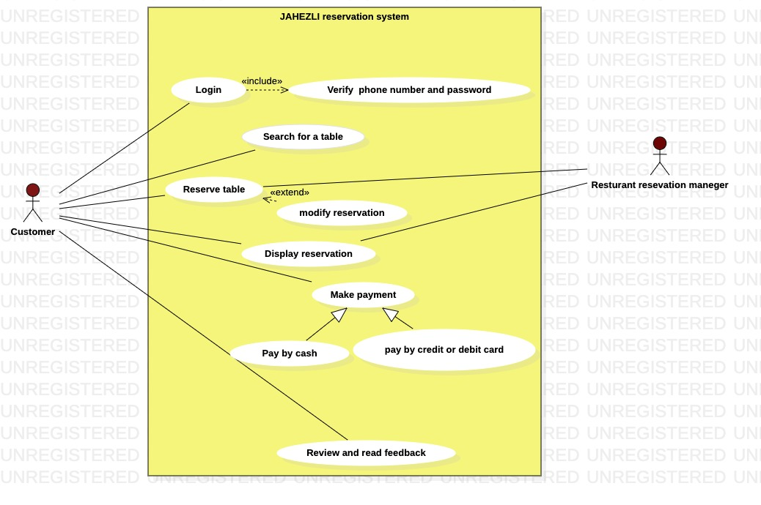
Use Case diagram

Slide 10
Use Case descriptions
Login
Search for table

Slide 11
Use Case descriptions
Reserve table
Make payment

Slide 12
Use Case descriptions
Display reservation
Review and read feedback

Slide 13
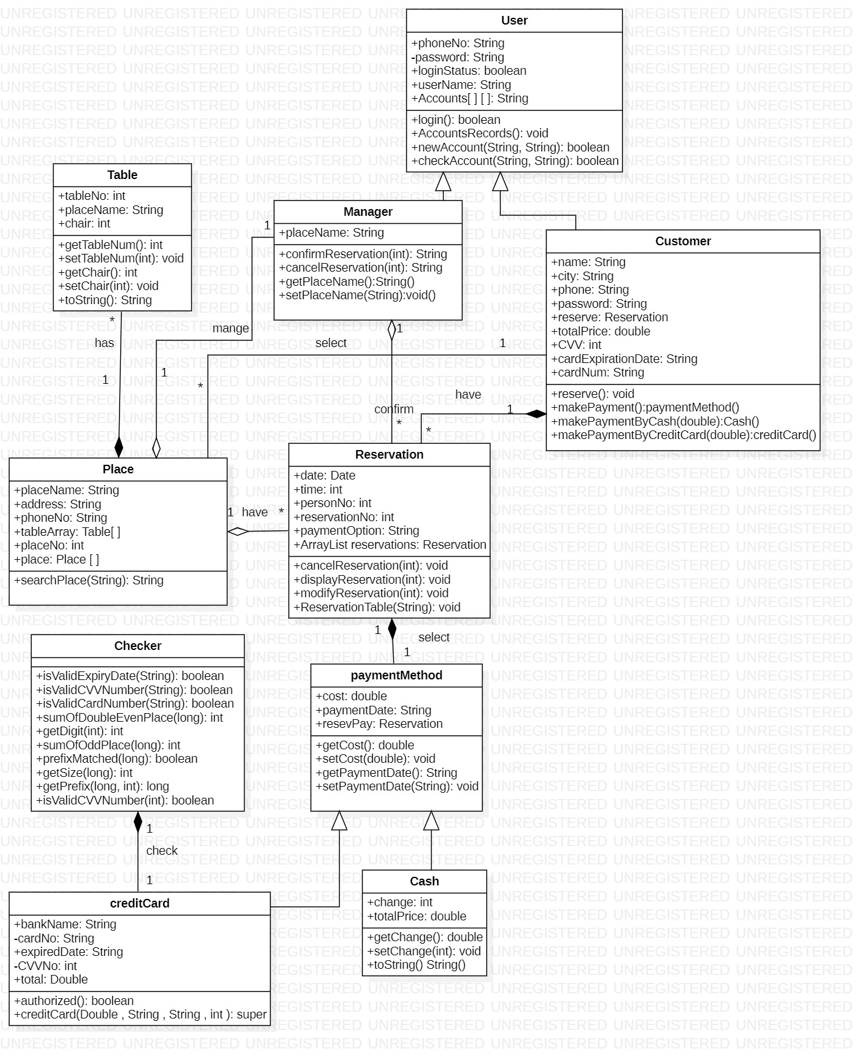
Class diagram

Slide 14
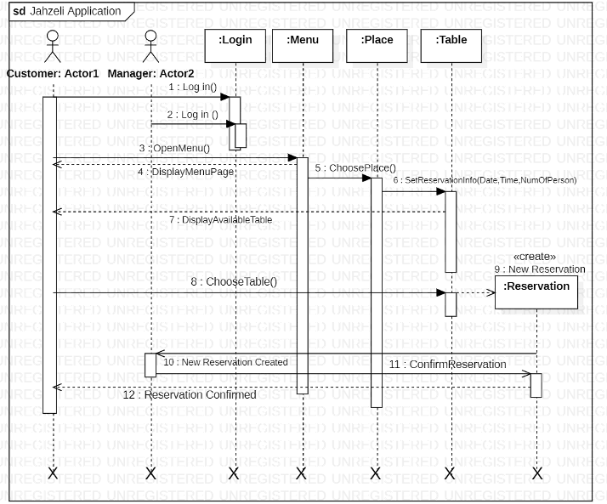
Search for a table sequence diagram

Slide 15
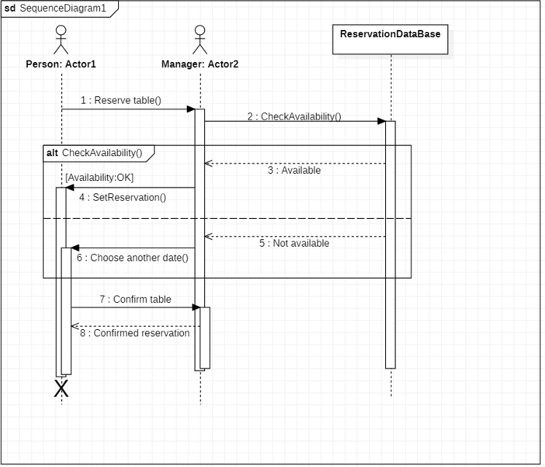
Reserve table sequence diagram
X
X

Slide 16
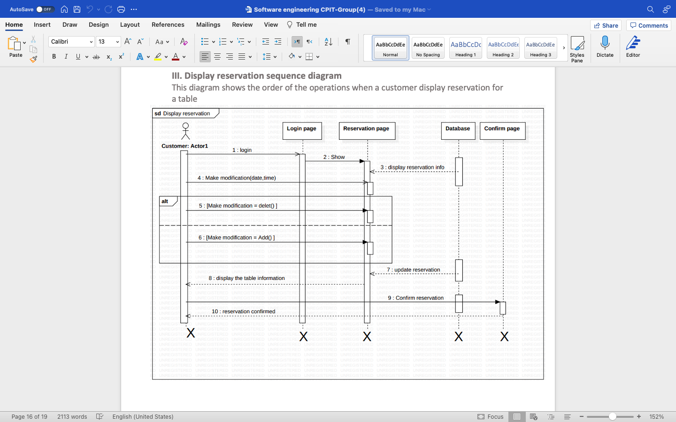
Display reservation sequence diagram

Slide 17
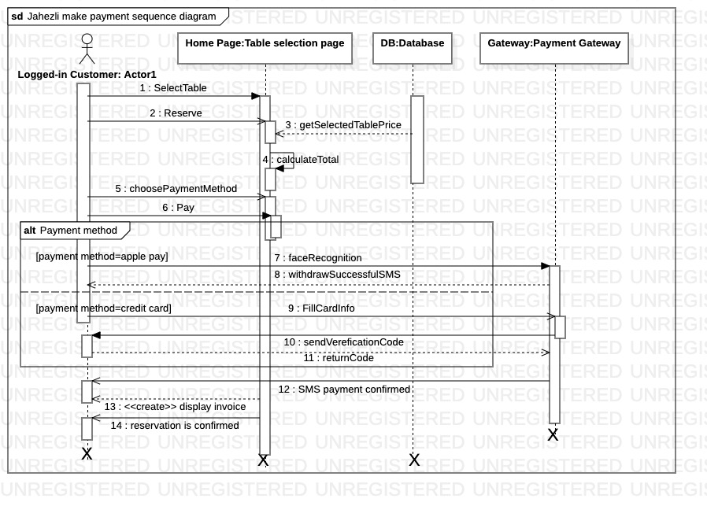
Make payment sequence diagram

Slide 18
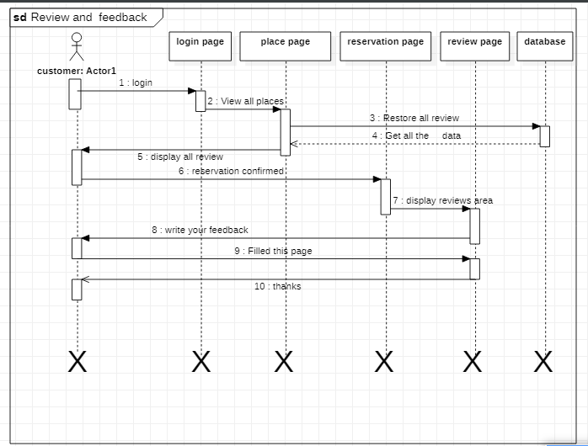
Review and read feedback sequence diagram

Slide 19
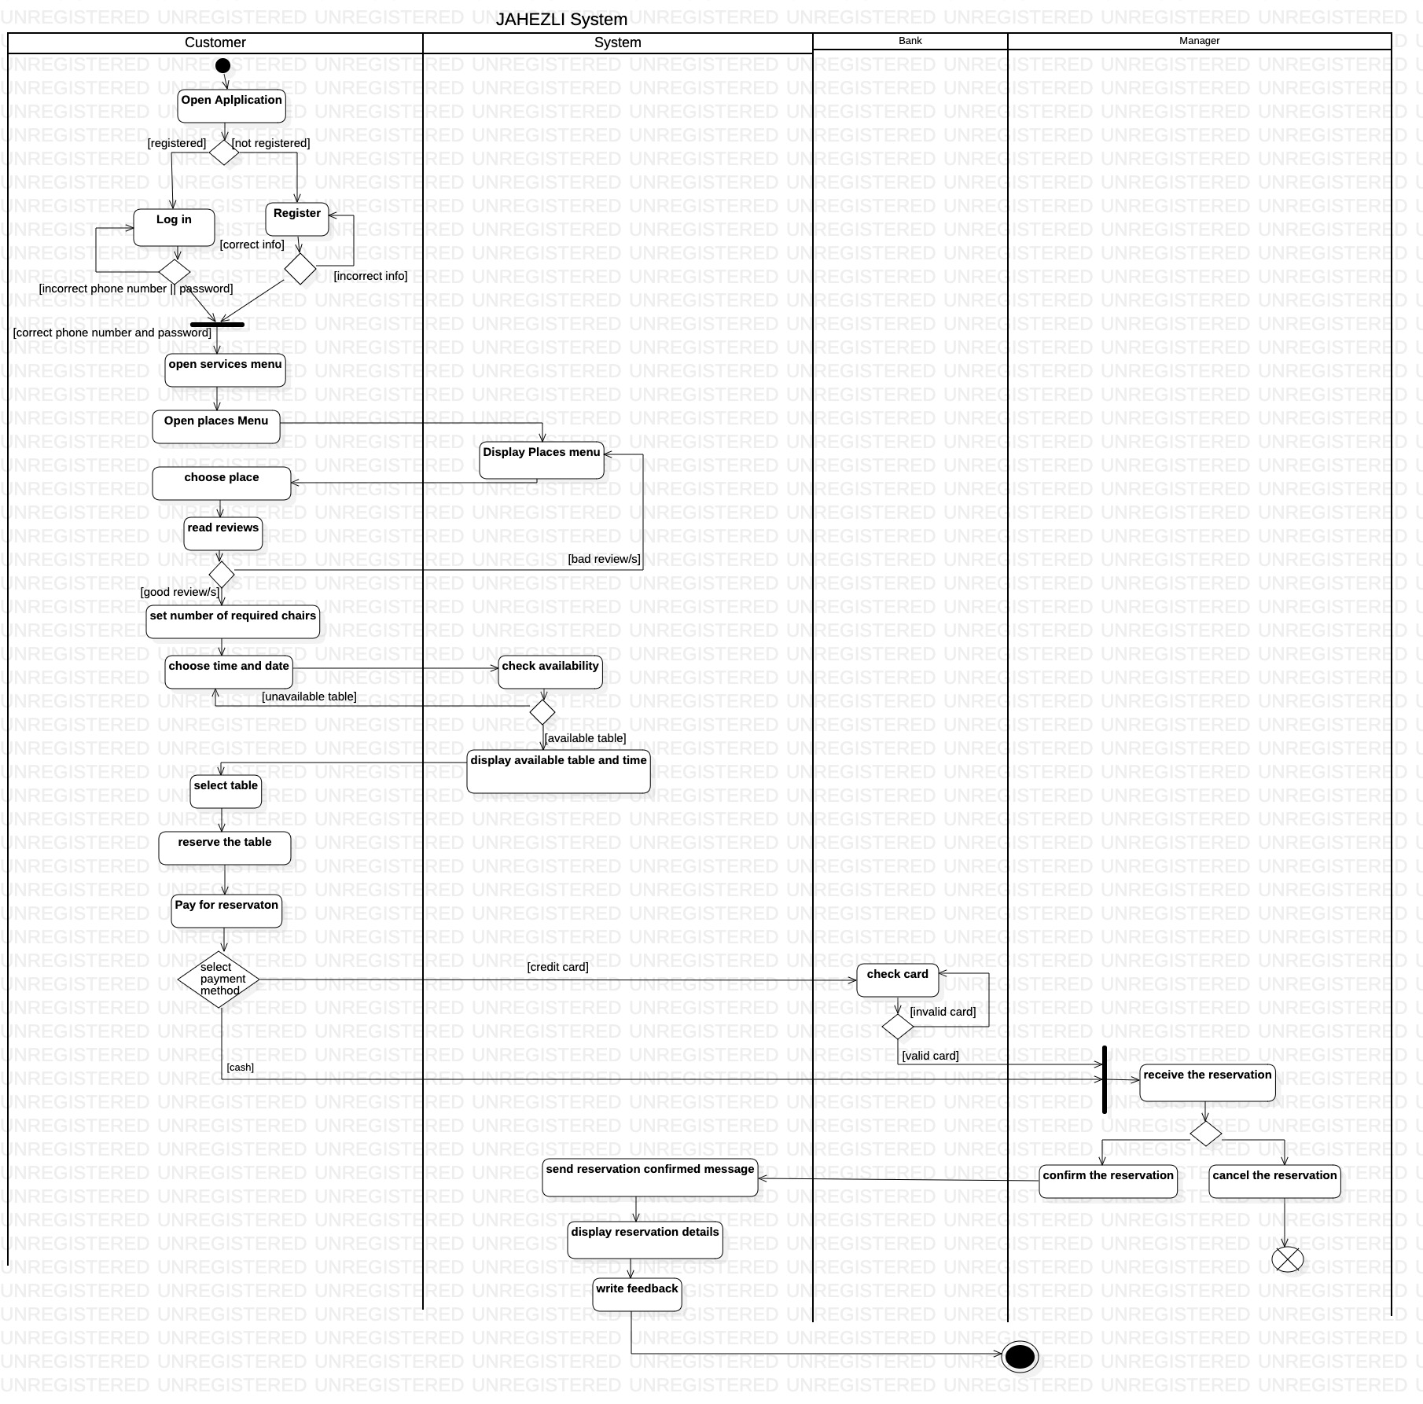
Activity diagram:

Slide 20
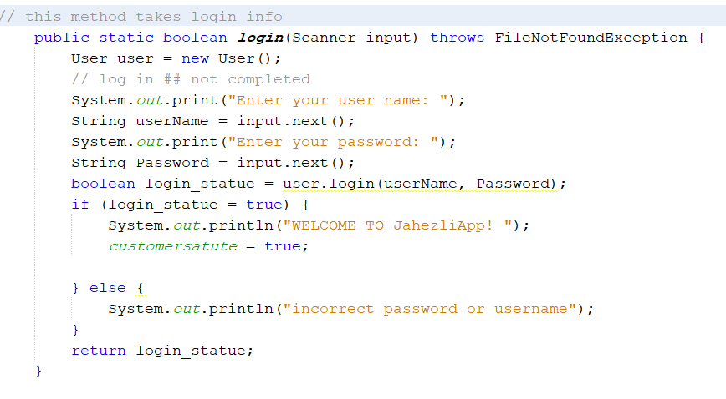
Implementation:
Login

Slide 21
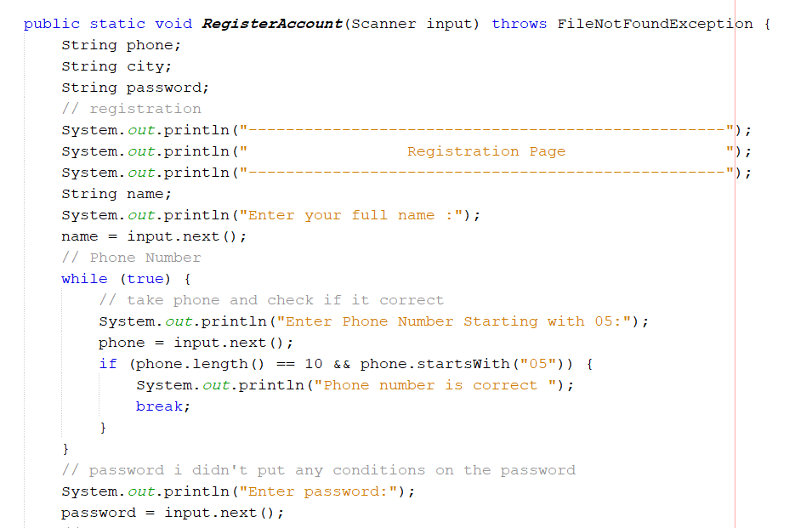
Implementation:
Registration 1

Slide 22
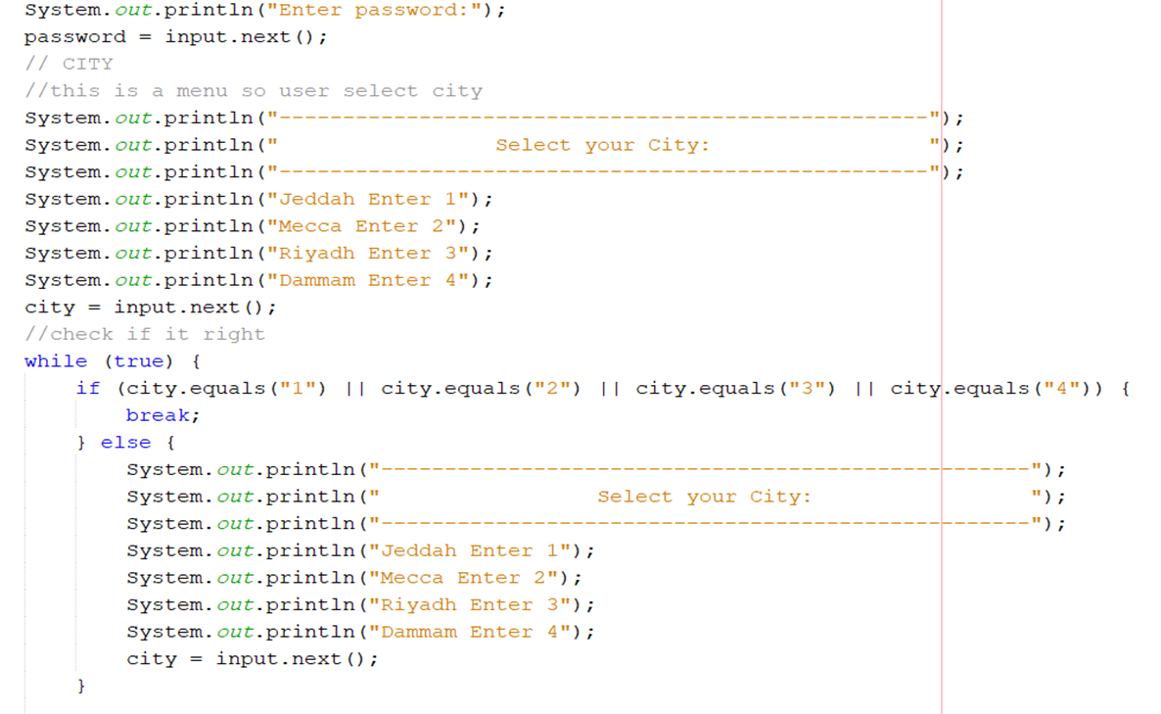
Implementation:
Registration 2

Slide 23
Implementation:
Registration 2

Slide 24
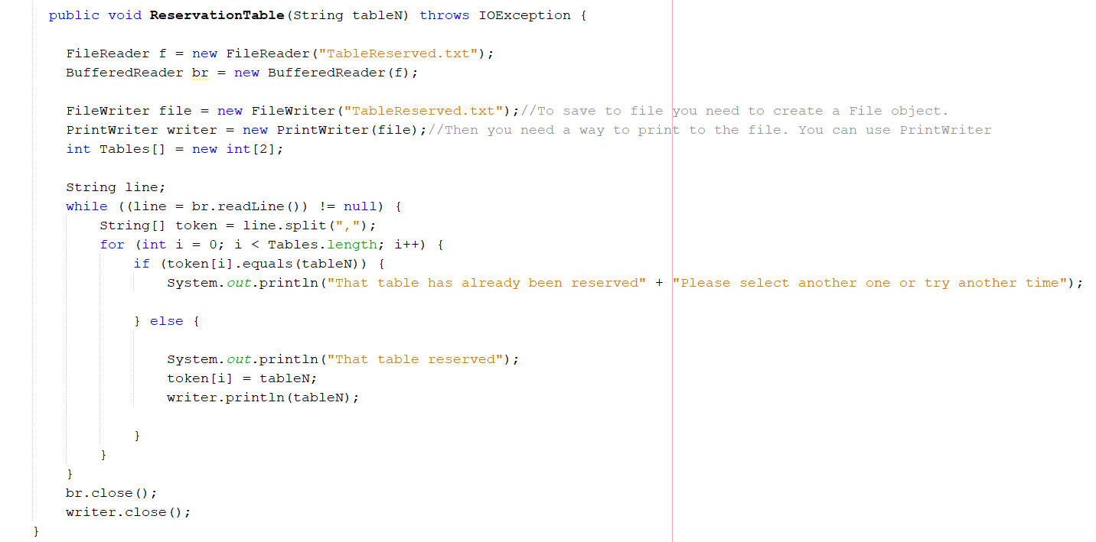
Implementation:
Reserve table

Slide 25
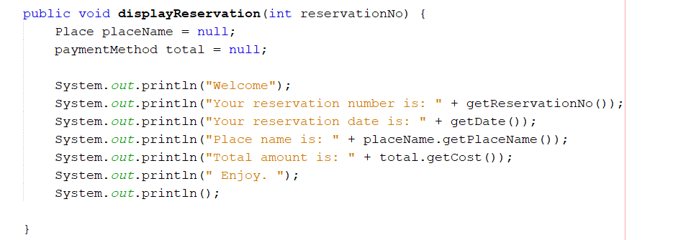
Implementation:
Display Reservation

Slide 26
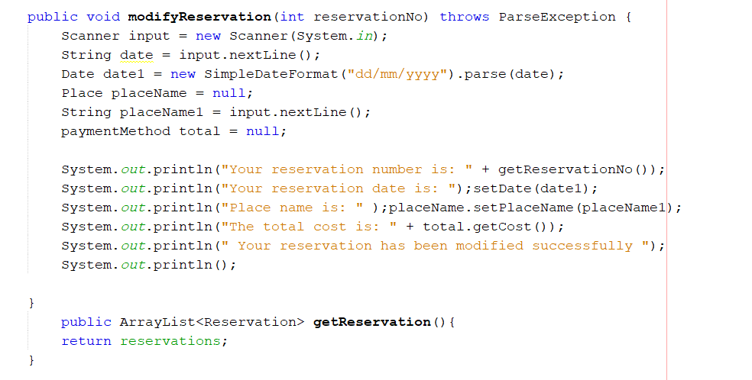
Implementation:
Modify reservation

Slide 27
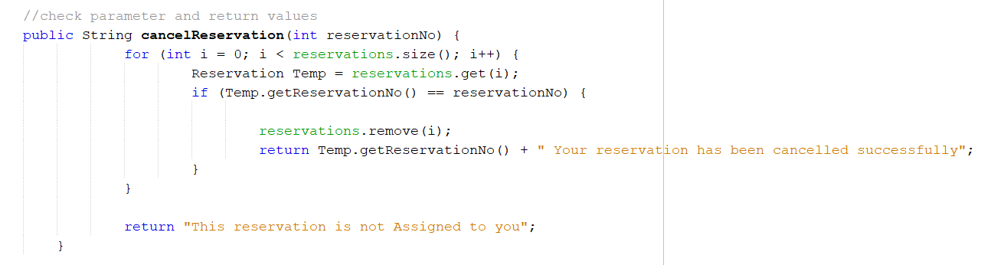
Implementation:
Cancel reservation

Slide 28
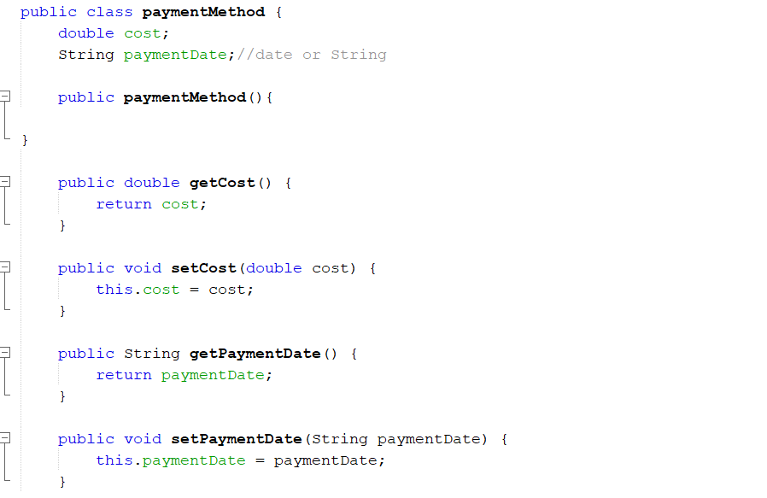
Implementation:
Make payment

Slide 29
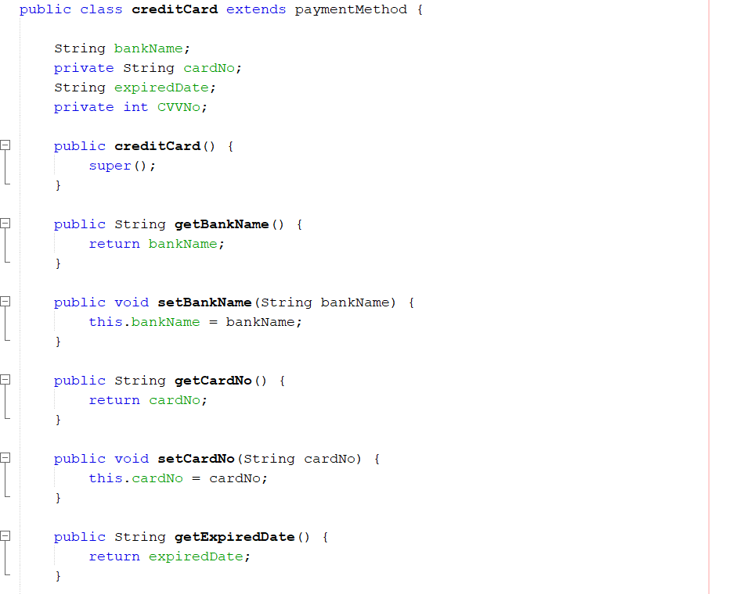
Implementation:
Pay by credit card 1

Slide 30
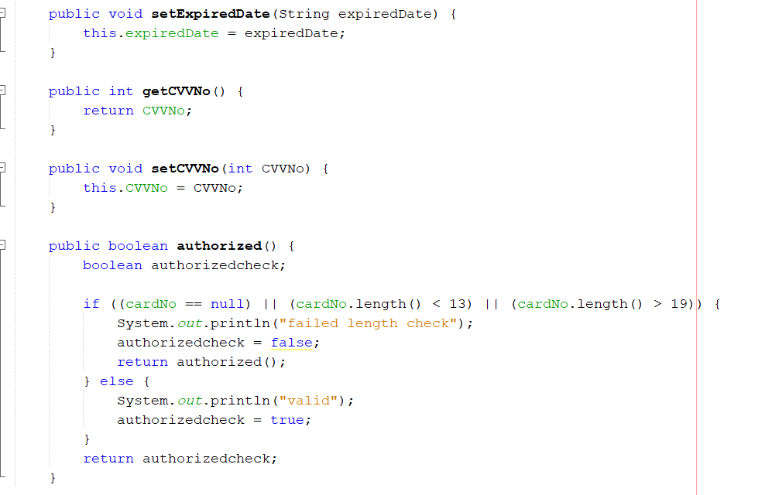
Implementation:
Pay by credit card 2

Slide 31
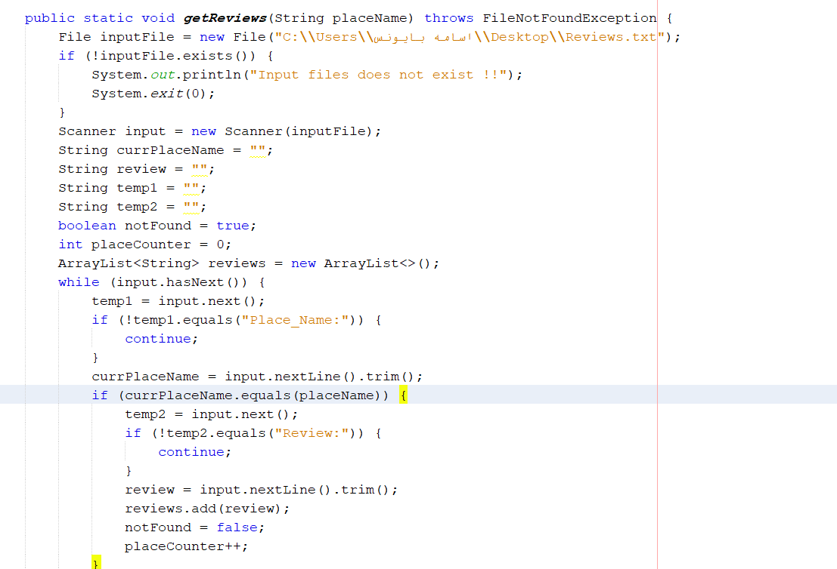
Implementation:
Review 1

Slide 32
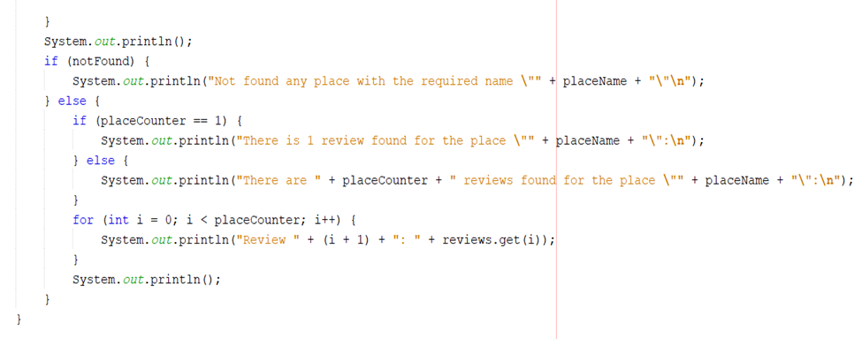
Implementation:
Review 2

Slide 33
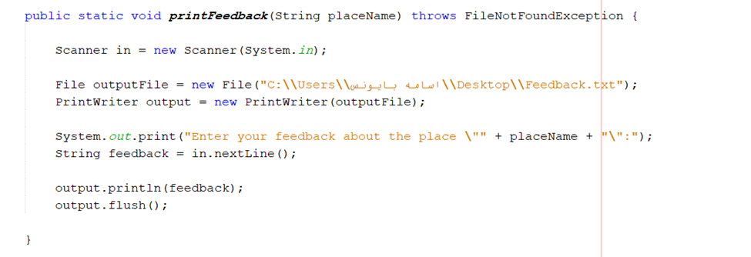
Implementation:
Feedback

Slide 34
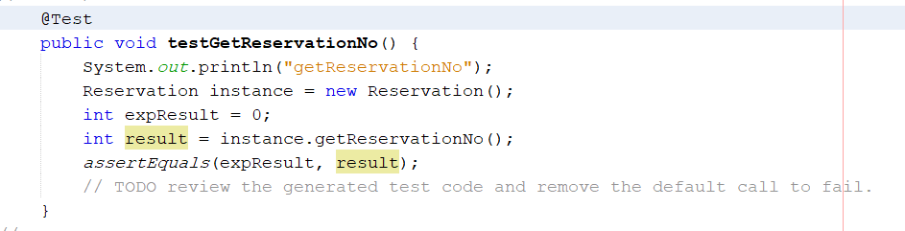
Testing:
Get Reservation No

Slide 35
Testing:
Result

Slide 36
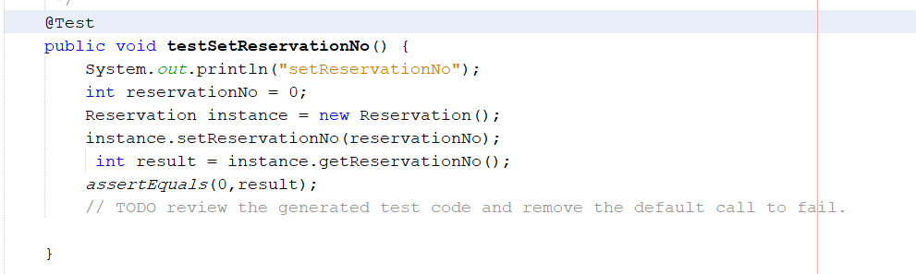
Testing:
Set Reservation No

Slide 37
Testing:
Result

Slide 38
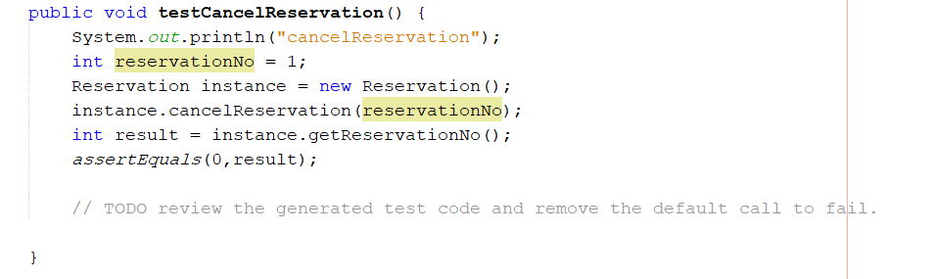
Testing:
Cancel Reservation

Slide 39
Testing:
Result

Slide 40
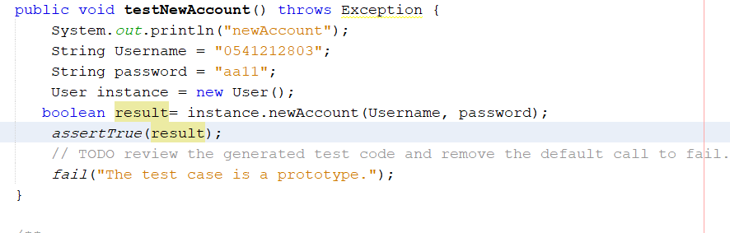
Testing:
New Account

Slide 41
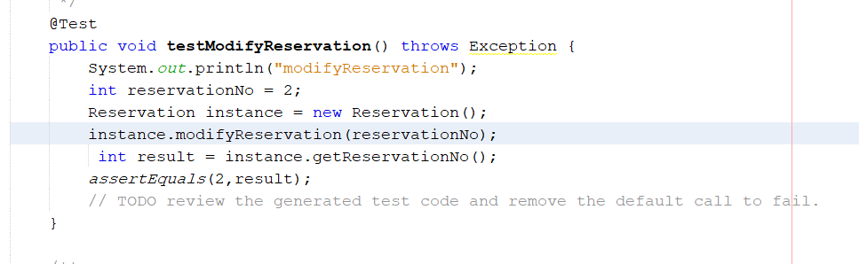
Testing:
Modify Reservation

Slide 42
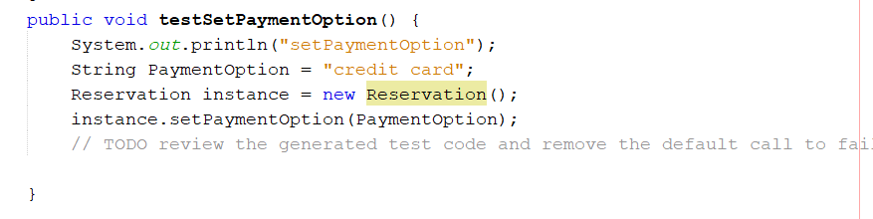
Testing:
Set Payment Option

Slide 43
Testing:
Result

Slide 44
Lessons learned:
1
How to plan the project
2
How to manage changes
3
How to stay the schedule

Slide 45
Challenges:
Execution code difficulties
Deal with GitHub
Deal with Testing class

Slide 46
Future work
We hope to be available for all cities in Saudi Arabia
Have our own Database instead of files to save information
Code maintenance to make it easier for the user to use and be more efficient later
DOWNLOAD

Slide 47
Conclusion
The main idea of Jahezli it to solve all problems we mentioned before. And add features such as:
Different payment methods
Modify the reservation
DOWNLOAD

Slide 48
Done by:
Jana Kurdi
Abeer Abdullah
Razan Alshaikh
Renad Ghaleb
Rawan Alzahrany
THANK YOU ☺

